Slide 1

Multi class Disease Diagnosis Using Multinomial Logistic Regression
COURSE : Machine learning
COURSE CODE: 25SC2107E
SECTION: 4
Branch: CSE
GUIDED BY: JYOTHSNA DATTI(Assistant professor)
2520030439 - Yetukuri uttej
2520030370– Gummadi hitesh
2026-2027

Slide 2
CONTENTS
ABSTRACT
INTRODUCTION
REQUIREMENT ANALYSIS
20 LITERATURE PAPERS IN TABLE FORMAT
DATASET DESCRIPTION

Slide 3
ABSTRACT
Multi-Class Disease Diagnosis Using Multinomial Logistic Regression is a machine learning-based system developed to classify patients into different disease categories using relevant medical features such as symptoms, age, test results, and other clinical attributes. The proposed system uses Multinomial Logistic Regression, which is suitable for problems involving multiple possible output classes. The model is trained using historical medical data to learn relationships between patient features and disease categories. It then predicts the probability of each disease and selects the most likely class. The system aims to provide fast, consistent, and data-driven decision support for disease classification. It can help reduce manual effort and support healthcare professionals in the early identification of possible diseases.

Slide 4
INTRODUCTION
Multi-Class Disease Diagnosis Using Multinomial Logistic Regression is a machine learning approach designed to predict and classify different diseases based on patient-related information such as symptoms, medical test results, age, and other relevant health features. Traditional disease diagnosis can be time-consuming and may depend heavily on manual analysis. Machine learning can assist by identifying patterns in medical data and providing a predicted disease category.
In this project, Multinomial Logistic Regression is used because the target variable contains more than two disease classes. The model analyzes the input features and calculates the probability of each possible disease, selecting the class with the highest probability as the predicted diagnosis. The system can help improve the speed and consistency of disease classification and can serve as a decision-support tool for healthcare professionals, rather than replacing professional medical diagnosis.

Slide 5
REQUIREMENT ANALYSIS
• Programming Language: Python
• Libraries: NumPy, Pandas, Scikit‑learn, Matplotlib, Seaborn
• ML Frameworks: Scikit‑learn (for Logistic Regression), TensorFlow or PyTorch (optional for extensions)
• Data Handling: CSV/Excel files for patient records, SQL/NoSQL databases for larger datasets
• Development Environment: Jupyter Notebook, PyCharm, or Visual Studio Code
• Version Control: Git and GitHub
• Operating System: Windows, Linux, or macOS
• Visualization Tools: Matplotlib, Seaborn, Plotly (for interactive plots)

Slide 6
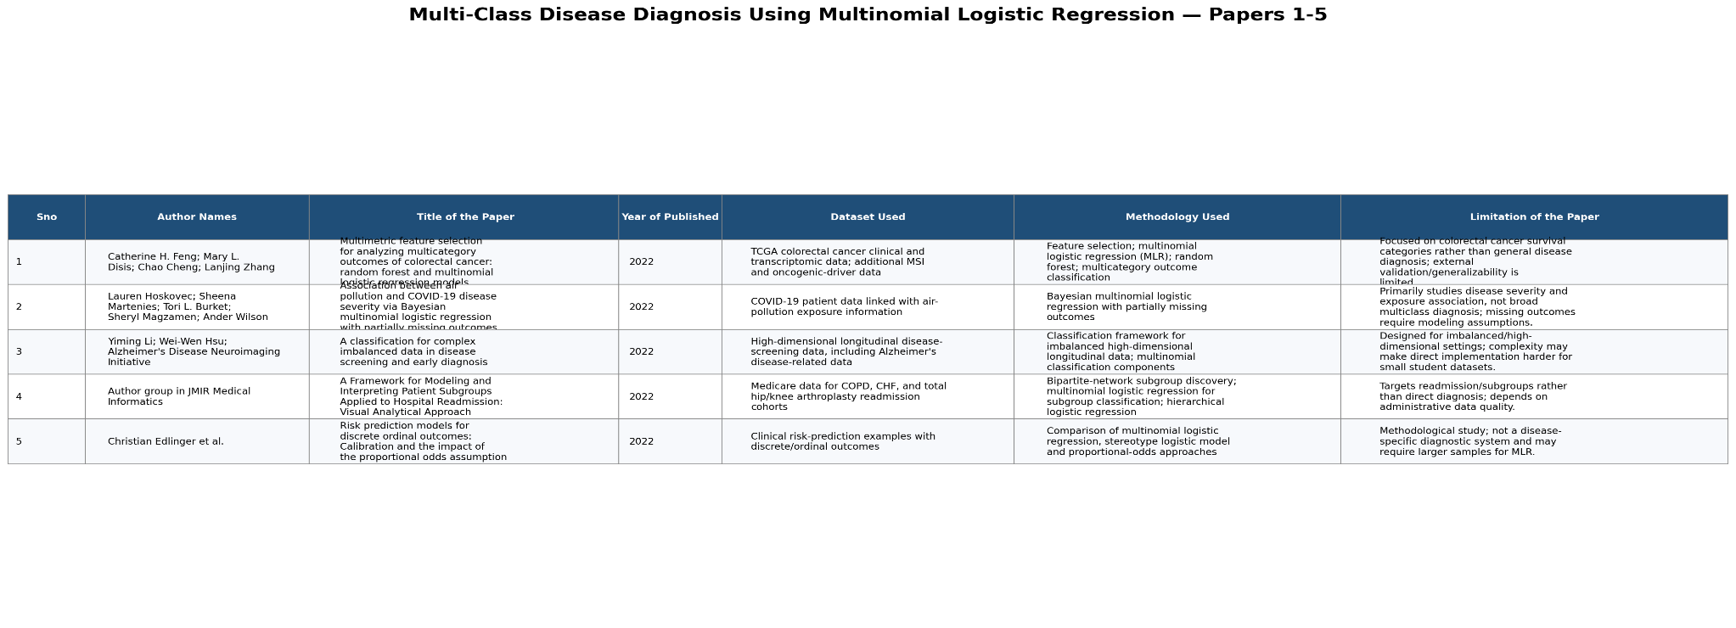
20 Literature papers (1 – 5)

Slide 7
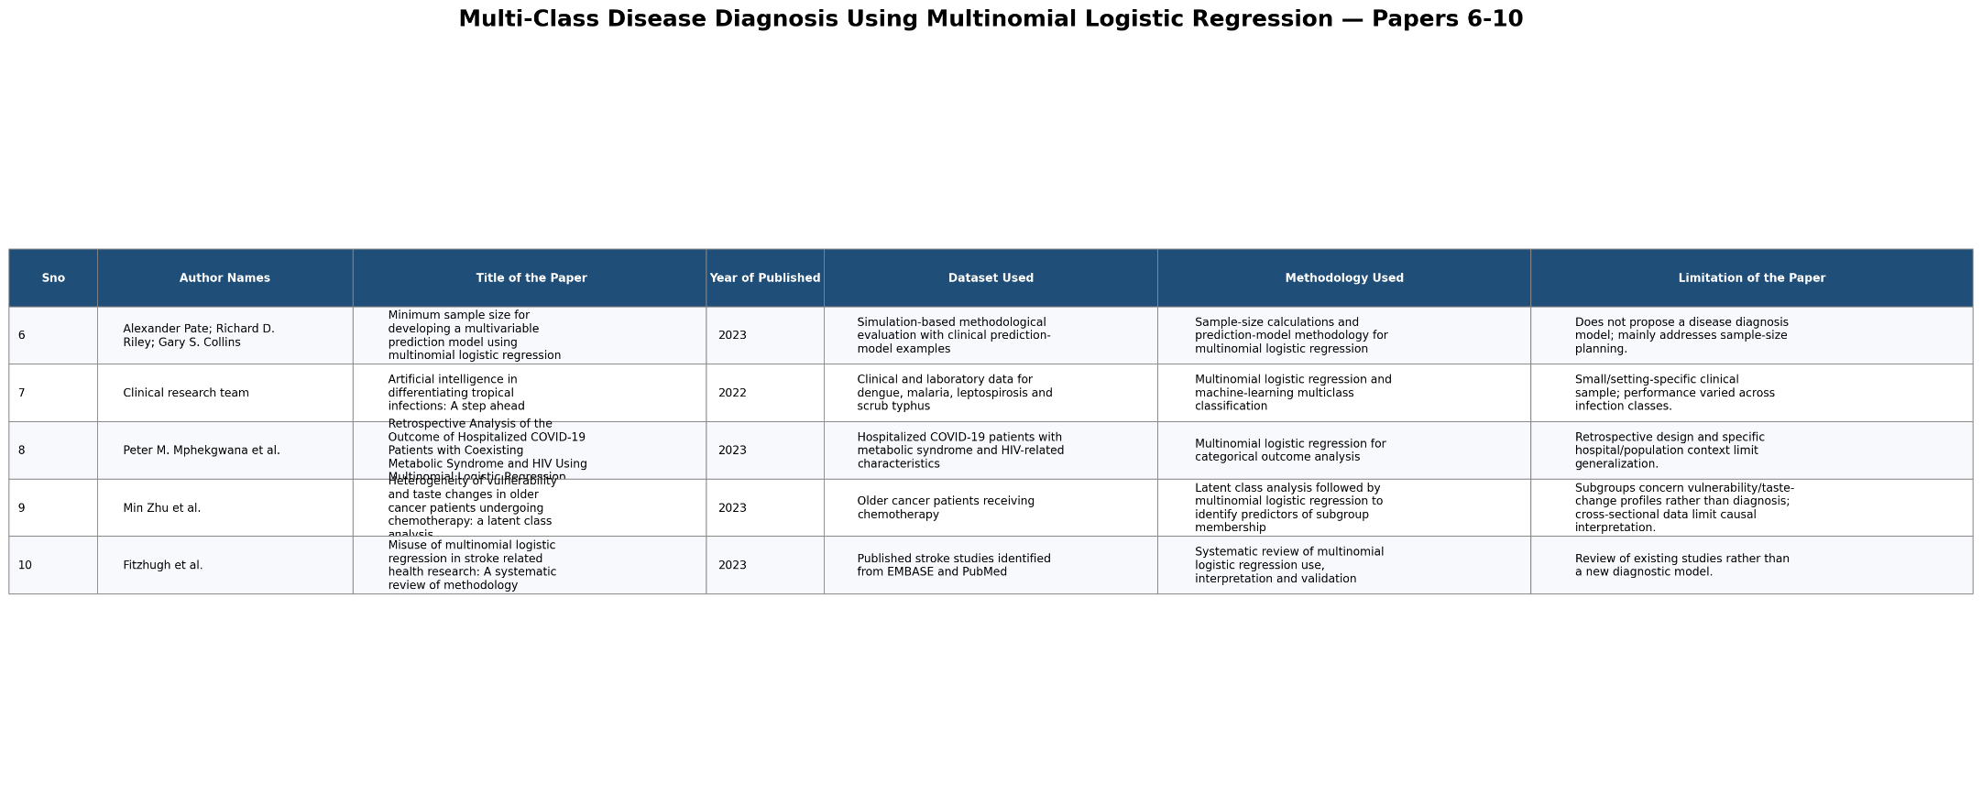
20 Literature papers (6 – 10)

Slide 8
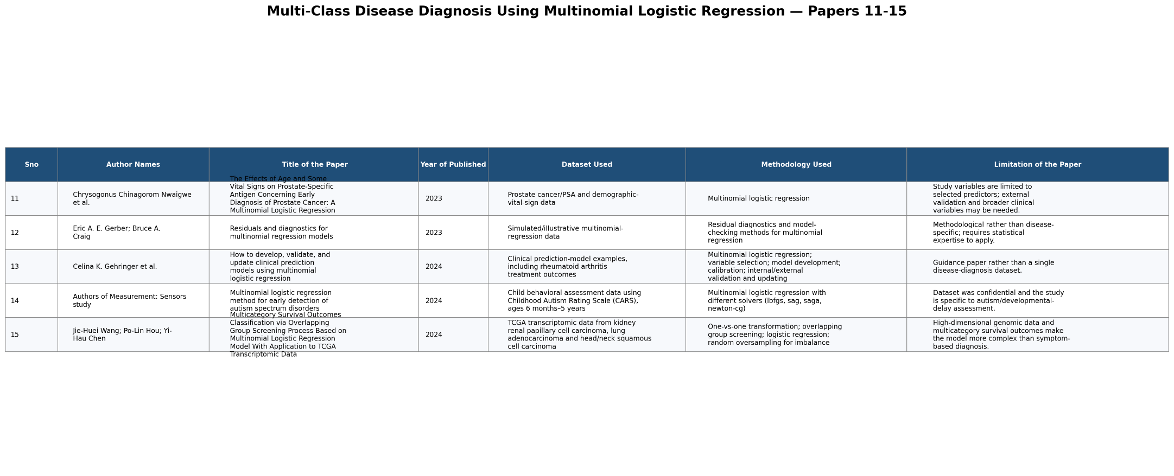
20 Literature papers (11 – 15)

Slide 9
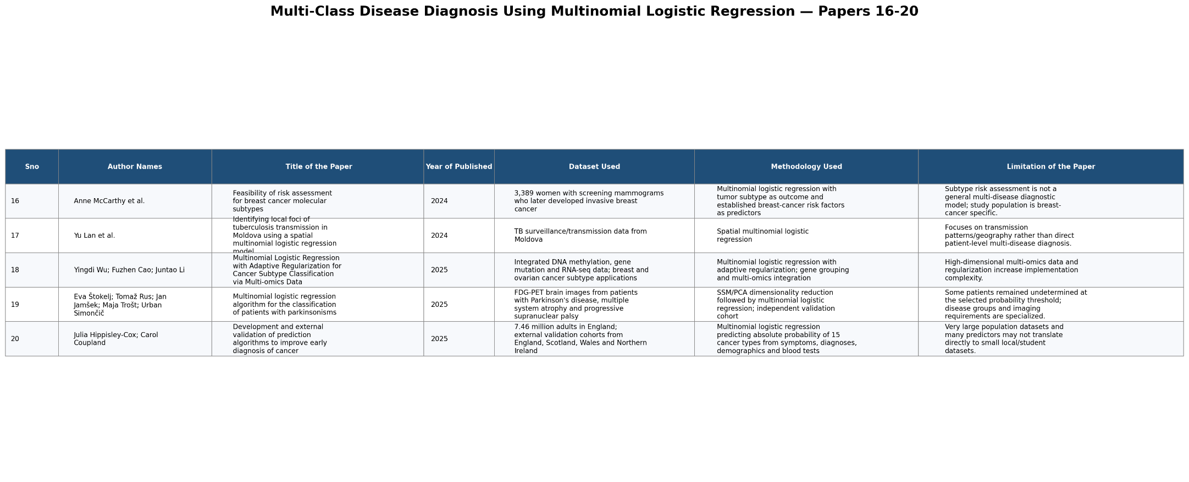
20 Literature papers (16 – 20)

Slide 10
DATASET Description
Patient Features: Age, gender, symptoms, and medical test results.
Input Variables: Clinical attributes used by the model for prediction.
Target Variable: Disease category to be predicted.
Multiple Classes: Represents different possible diseases.
Data Preprocessing: Missing values, categorical values, and numerical features are handled before training.
Training Data: Used to build the classification model.
Testing Data: Used to evaluate the model's performance.

Slide 11
THANK YOU

